Slide 1
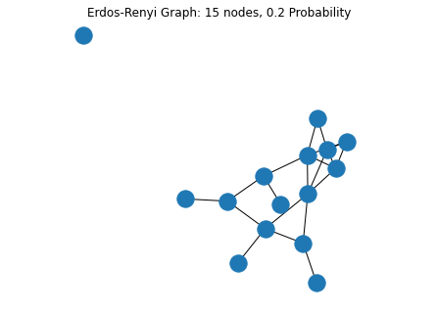
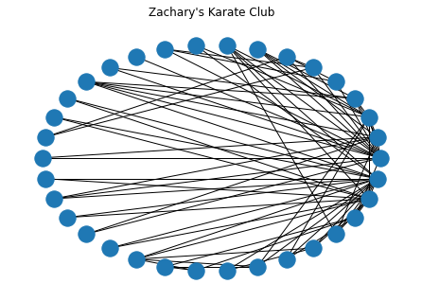
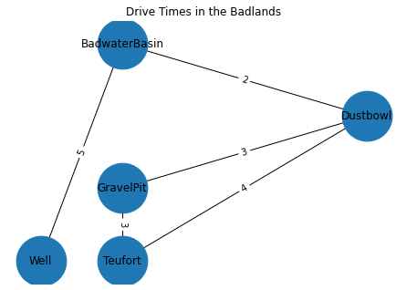
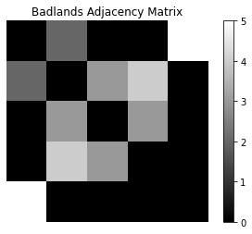
Introduction to Networks
App Physics 157 FX-1 1 of 7
Presented by Soriano, Edneil E. Jr.
S.N. 202002420

Slide 2
Objectives
App Physics 157 FX-1 2 of 7
To create simple graphs and determine when the model might be useful
To determine the degree distribution of a graph, and enumerate other properties of interest
To calculate the adjacency matrix of a graph and explain its properties

Slide 3
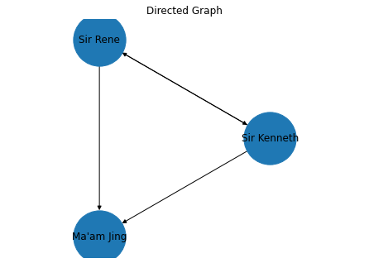
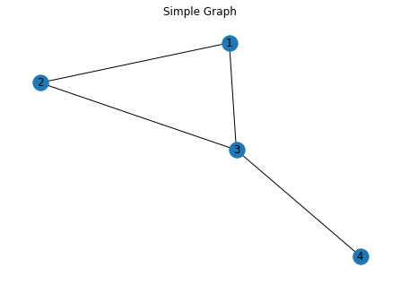
App Physics 157 FX-1 3 of 7
Network Types
A directed graph is different from a simple graph only in the lack of reciprocity in its edges. This one way direction is usually denoted as an arrow. These graphs have a reverse graph.
All parts of the universe are interconnected in one way or another – networks are everywhere and so the tools we use to manipulate and study them are of utmost importance. To begin our study of complex networks, we first create two simple graphs using Python’s NetworkX library. First, we create a simple graph, directed, and a weighted graph.
Fig 2. A directed graph with |V| = 3, and|E| = 4
A weighted graph has attached weights to each edge which can represent any information we want.
Fig 1. A simple graph with 4 nodes V (stands for vertices), and 4 edges E
A simple graph is characterized by nodes V, connected by reciprocal edges E. It just means simple, nothing more than connected vertices. We usually denote graphs as G(V, E). Even with the simplicity of simple graphs, it’s still powerful!
Fig 3. A weighted network, with weights denoting hours of driving

Slide 4
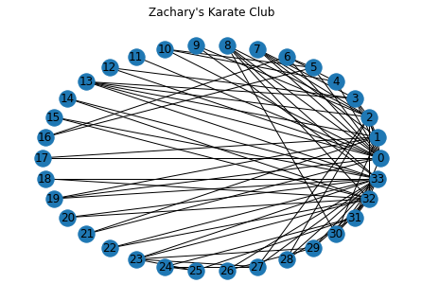
App Physics 157 FX-1 4 of 7
Other Types and Degree
Now that we know different types of network, we move on to actually working with them. There are many properties we usually measure concerning graph, but one of the most important is degree. This is a property of a node that tells us how connected that particular node is to others. In Fig 4. below, I load Zachary’s karate club then determine each node’s degree. We then use the weights stored in each edge to generate a degree distribution in Fig 5.
There are many other network types used in complexity science, some are listed below:
Bipartite Networks – Graphs that have two types of nodes. Edges can only connect nodes of different types. If we have n of nodes then we generalize to an n-partite network.
Multigraphs – We allow multiple (parallel) edges to connect nodes. I’m quite familiar with this as I use this in my research because the library I use represents road networks to multigraphs!
Multilayer Networks – Different layers representing how different nodes can connect in different ways. Each layer can connect with each other (many to many).
Signed Networks – Multilayer network with just two layers, one representing “friendship” and one representing “enmity”.
Hypergraphs – Contains hyperedges that can connect more than two nodes at the same time.
Dynamic Graphs – Contains temporal information on nodes and edges to model evolving systems.
Fig 4. Zachary’s karate club comprising 33 nodes and weighted edges

Slide 5
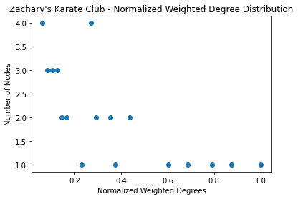
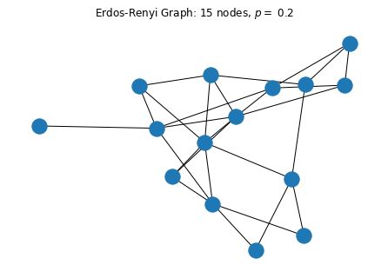
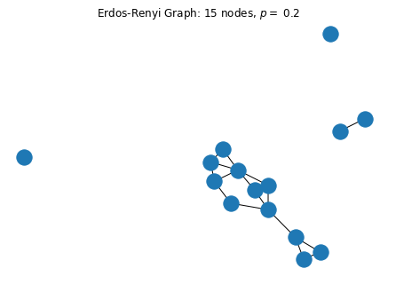
App Physics 157 FX-1 5 of 7
Degree Distribution Random Graphs (Erdos-Rényi)
To explore various network properties, one must first create a network (amazing, I know). Suppose we want to model plant epidemics and how they spread through out time using a novel model. One way to generate your network in this case is by making an Erdos-Rényi (ER) graph, particularly the G(n,p) kind.
In the G(n,p) model, a graph is generated by connecting nodes based on a probability p. Each edge is included independently of any other edge. In Fig 6., I generate these graphs…
Fig 5. Degree distribution of Zachary’s karate club
Since the network is weighted, the contribution of each edge to a node’s degree are different unlike in a simple graph. Since Zachary’s karate club is not a complex network, its degree distribution appears discrete and does not follow typical trends such as a power law or a log-scale.
Networkx also provides functions to calculate the clustering coefficient of each node, and shortest path length using Dijkstra’s or Floyd-Warshall’s algorithm. The former shortest-path algorithm is of course used in origin-destination analysis and the latter for analyzing the whole network
Fig 6. Randomly generated ER graphs with the same parameters
There are other types of graphs we can use, such as random geometric etc., but it is up to the scenario we model what to use.

Slide 6
App Physics 157 FX-1 6 of 7
Adjacency Matrix
The adjacency matrix is a basic representation of a graph as a matrix (I know, shocking). To explore its properties, let us first create a graph. For this example, I make a weighted graph whose nodes are dependent on position shown in Fig 7.
Fig 8. Adjacency matrix of the network in Fig 7. Note that it is a square matrix that is mirrored with respect to the diagonal. Moreover, this diagonal is comprised of 0’s
We highlight some qualities of this adjacency matrix:
It is a square matrix since it is not an n-partite network. The graph is just a simple weighted graph.
The diagonal is a 0 diagonal because there are no self-loops present in the network
The matrix is mirrored with respect to the diagonal because all edges have reciprocity. If this were a directed graph, it would be a different story.
With this matrix, we can perform various operations on a network, like find its complement, or its Laplacian, etc…
Fig 7. A weighted graph with 5 nodes. The positions of the nodes were defined manually. The network is non-directed and has no self-loops
Now we can generate the adjacency matrix! Each row/column corresponds to a node, and the elements of the matrix represent each connection as shown in Fig 8.

Slide 7
Key Takeaways
App Physics 157 FX-1 7 of 7
There are many ways to construct a network, and choosing which one to build relies on the physical phenomena we want to model
A network has many properties of interest that we usually want to measure such as its degree distribution, the shortest path between nodes, and the clustering coefficient of its nodes
One can generate random graphs as synthetic data in order to explore these properties.
A network can be represented by an adjacency matrix, which can be acted upon by operators to transform the network.
Reflection
The reference for this activity was really interesting – I liked the writing style of the author and how ideas are introduced. However, I had little time to touch on all the details of each chapter as the semester nears its end. In fact out of all the activities, I was forced to spend the least time on this one (also because of the neural network module). It is a good thing that I’m already familiar with many of the concepts in the reference due to being part of the Complex Systems Laboratory of the institute! When conducting preliminary work for my (future) research, I needed to learn how complex networks behave and what properties we can extract from them. It’s cool to know I’m actually learning things ahahahaha…
I asked the other class about what they did for this activity and based on their stories, I was able to demonstrate more techniques that what was required of them. Because of this, I think I deserve a 100/100. I know I wasn’t able to include some network tools and concepts, but as an introductory activity I think I covered more than enough.
Reference
[1] M. Coscia. The Atlas for the Aspiring Network Scientist. 2021. Chapters 3, 4, 6, 9, 10, 11, and 14. https://www.networkatlas.eu

